Slide 1
Agents Workshop
// SETUP GUIDE
Smart Agent in 10 minutes
Git
Ollama
uv
Streamlit
MLflow
8 steps · about 15 minutes

Slide 2
Install Git
STEP 1
$ brew install git
macOS
git-scm.com/downloads
Windows
$ sudo apt install git
Linux
agents-workshop · setup guide
Step 1 of 8

Slide 3
Clone the Repository
STEP 2
$ git clone https://github.com/mohamedadaly/agents-workshop.git
$ cd agents-workshop
agents-workshop · setup guide
Step 2 of 8

Slide 4
Install an Editor (or Skip It)
STEP 3
VS Code (recommended)
Terminal only
Download from code.visualstudio.com
No editor required — every step here runs from a terminal.
$ code .
agents-workshop · setup guide
Step 3 of 8

Slide 5
Install Ollama & Pull a Model
STEP 4
ollama.com/download
Download
$ ollama pull qwen3.5:4b-mlx
Pull the model
Make sure Ollama is running — it starts automatically after install, or run ollama serve.
agents-workshop · setup guide
Step 4 of 8

Slide 6
Install uv
STEP 5
$ curl -LsSf https://astral.sh/uv/install.sh | sh
Windows: see docs.astral.sh/uv/getting-started/installation
agents-workshop · setup guide
Step 5 of 8

Slide 7
Install Project Dependencies
STEP 6
$ uv sync
Reads pyproject.toml / uv.lock and creates a local .venv with everything installed:
streamlit
gradio
deepagents
langchain-ollama
langchain-community
mlflow
ddgs
agents-workshop · setup guide
Step 6 of 8

Slide 8
Run the App
STEP 7
Streamlit
$ uv run streamlit run 01_deep_agent_streamlit.py
Gradio
$ uv run python 01_deep_agent_gradio.py
Same agent, two UIs — either opens in your browser. Pick a model, confirm the database URI (defaults to data/Chinook.db), then click Connect before chatting.
agents-workshop · setup guide
Step 7 of 8

Slide 9
View MLflow Traces
STEP 8 · OPTIONAL
Every question you ask is traced automatically. In a separate terminal:
$ uv run mlflow ui --backend-store-uri sqlite:///data/mlflow.db
Then open the URL it prints — typically http://localhost:5000
agents-workshop · setup guide
Step 8 of 8

Slide 10
Anatomy of the Agent
// CODE WALKTHROUGH
Four pieces, wired together in build_agent()
Model
Tools
Prompt
Memory
Agent
→
→
→
→
agents-workshop · code walkthrough

Slide 11
A Local Ollama Model
1 · MODEL
llm = ChatOllama(
model=model,
base_url=base_url,
validate_model_on_init=True,
temperature=0,
)
Picked in the sidebar at connect time. temperature=0 keeps SQL generation deterministic; validate_model_on_init fails fast if the model isn’t pulled yet.
agents-workshop · code walkthrough
1 of 6

Slide 12
Database & Tools
2 · TOOLS
db = SQLDatabase.from_uri(db_uri)
tools = SQLDatabaseToolkit(db=db, llm=llm).get_tools()
+ [DuckDuckGoSearchRun()]
The toolkit, plus one web-search tool, hands the agent five tools:
sql_db_list_tables
sql_db_schema
sql_db_query_checker
sql_db_query
duckduckgo_search
agents-workshop · code walkthrough
2 of 6

Slide 13
Steering the Agent
3 · SYSTEM PROMPT
Passed as system_prompt=INSTRUCTIONS — four rules keep the ReAct loop safe and on-task:
Look before you query
Check before you run
Verify table names with sql_db_list_tables, inspect schemas with sql_db_schema first.
Run non-trivial queries through sql_db_query_checker before sql_db_query.
Read-only, always
Plan multi-step work
No INSERT, UPDATE, DELETE, DROP — ever.
Use the agent’s built-in todo list before a multi-step question.
agents-workshop · code walkthrough
3 of 6

Slide 14
The Prompt, Verbatim
4 · SYSTEM PROMPT
You are an agent designed to interact with a SQL database.
Given an input question, create a syntactically correct sqlite query, run it, inspect the results, and return a concise answer. Unless the user asks for a specific number of rows, limit results to at most 10. Never SELECT * — only request the columns you need.
Do NOT issue any DML statements (INSERT, UPDATE, DELETE, DROP, etc.).
Always verify table names with sql_db_list_tables and inspect schemas with sql_db_schema before writing a query. Use sql_db_query_checker on any non-trivial query before running it with sql_db_query.
For multi-step questions, use your todo list to plan the steps before you start querying.
Use duckduckgo_search only for questions that need outside/current information the database can’t answer. Prefer the SQL tools whenever the question is about the data itself.
Answer in plain language. Do not describe the database schema or the steps you took.
agents-workshop · code walkthrough
4 of 6

Slide 15
Memory via Checkpointer
5 · MEMORY
checkpointer=InMemorySaver()
run_config = {"configurable": {"thread_id": thread_id}}
agent.invoke({"messages": [...]}, config=run_config)
Same thread_id on every turn — the checkpointer replays the full message history, so the agent remembers earlier questions in the conversation.
agents-workshop · code walkthrough
5 of 6

Slide 16
create_deep_agent()
6 · ASSEMBLE
agent = create_deep_agent(
model=llm,
tools=tools,
system_prompt=INSTRUCTIONS,
checkpointer=InMemorySaver(),
)
create_deep_agent wraps all four pieces in a LangGraph ReAct loop, with planning and a virtual file system built in — this agent only ever reaches for the four SQL tools above.
agents-workshop · code walkthrough
6 of 6

Slide 17
ReAct: Reasoning + Acting
// WHAT POWERS THIS AGENT
The pattern behind create_deep_agent’s loop — and most LLM agents since 2022.
Thought
Action
Observation
Answer
→
→
→
agents-workshop · the ReAct pattern

Slide 18
Why It Was Invented
1 · ORIGIN
Two 2022-era approaches each got half the job done:
Reasoning-only (Chain-of-Thought)
Acting-only agents
Great at step-by-step logic, but frozen in time — no way to look anything up, so it confidently hallucinates facts it can’t know.
Can call tools, but act impulsively — no visible plan, hard to debug, and errors compound with no reflection.
ReAct (Yao et al., 2022) interleaves both: reasoning steers which action to take next, and each action’s result corrects the reasoning.
agents-workshop · the ReAct pattern
1 of 4

Slide 19
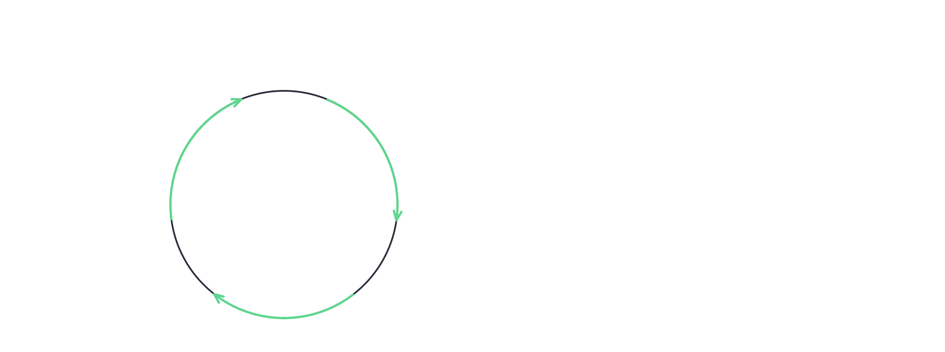
How the Loop Works
2 · MECHANICS
Thought
enough info
Answer
Decides what to check next.
Replies with no more calls.
Observation
Action
The tool’s result comes back.
Calls a tool to find out.
agents-workshop · the ReAct pattern
2 of 4

Slide 20
Mapped Onto the Code
3 · IN THIS AGENT
ReAct step | In this agent’s trajectory
Thought | folded into the model’s next tool call
Action | AIMessage(tool_calls=[sql_db_schema(...)])
Observation | ToolMessage(content=<query result>)
Repeat | LangGraph’s model ↔ tools nodes run again
Answer | AIMessage, no tool_calls → trajectory[-1].content
Every row above is exactly what the Agent trajectory expander in the app shows you, turn by turn.
agents-workshop · the ReAct pattern
3 of 4

Slide 21
Why It Matters
4 · PAYOFF
Grounded
Interpretable
The agent checks the real schema instead of guessing a column name — fewer hallucinated facts.
Every thought, action, and observation is a message you can read — literally the trajectory expander.
Recoverable
Extensible
A bad query doesn’t fail silently — the next loop iteration can look again and correct course.
Deep agents layer planning and sub-agents on top of this same Thought → Action → Observation core.
agents-workshop · the ReAct pattern
4 of 4

